Slide 1
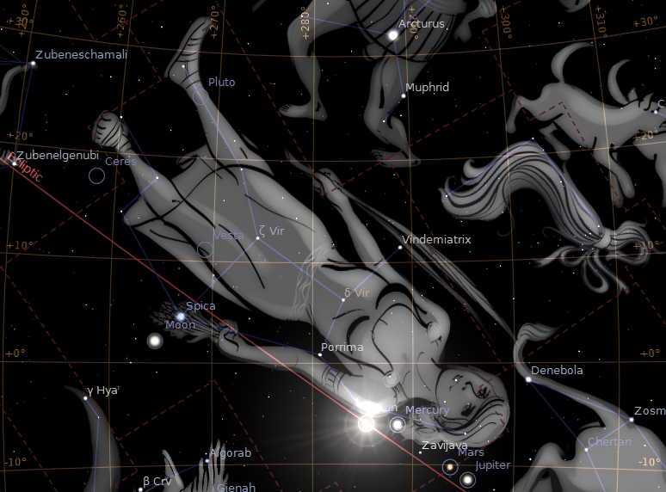

The Year and Day of Messiah’s Birth
And a great sign appeared in heaven: a woman clothed with the sun, and the moon under her feet, and on her head a crown of twelve stars; and she was with child; and she cried out, being in labor and in pain to give birth.. (Rev. 12:1-2).
In this presentation, I show that Messiah was born on Tishri 1, 2 B.C.
I often hear the objection that Revelation 12 is only a prophetic passage of the future. We have to take the “only” out of that statement to make it true, because some passages have more than just one intended meaning. This one has at least two, 1. historical sense where the woman is Miriam, and 2a. A prophetic sense where the woman is Israel fleeing Jerusalem in
AD 66, and 2b. A prophetic sense where the woman at some future date flees from the anti-Messiah. All of the above senses are valid. We should not put limits on the number of senses the Holy Spirit may wish to communicate in a text, and we should be willing to see those most literal senses which correlate with the facts.
The moon lines up “under her feet” as the Revelation text says.

Slide 2
This scene is taken directly from the public domain open source program Stellarium. It is set for the date of Aug 31, 2 B.C. The view is from Jerusalem, and the time is some minutes after sunset when the new moon becomes visible, which makes this date Tishri 1, the first day of the 7th month, called Yom Teruah .
The Yallop rating for this new moon is “A: Easily Visible”; one day earlier, the moon could not be seen, and one day later the moon would not line up under the feet (or legs) of Virgo.
There are actually 12 stars here of magnitude 6 or less, i.e. which can be seen by the naked eye. These are the 12 tribes of Israel
The sun is only in this position in the fall of the year. The woman is never “clothed with the sun” at any other time. The sun only spends 45 days in Virgo, and only about 5 days next to the shoulder, at which position “clothed with the sun” makes the most sense.

Slide 3
Virgo always appears in this orientation near the new moon for Tishri 1. However, the sun is not always optimally positioned near the shoulder in every year on Tishri 1. Also, on Tishri 1, the moon is not always under the feet of Virgo.
The best match is in the year 2 BC. In 3 BC the moon completely misses being under the feet at the new moon. In 4 BC the sun is near the legs on Tishri 1, and the new moon is off the screen past the star Zubenelgenubi. In 1 BC the sun is near Spica, and the moon is to the left of Zubenelgenubi.
In order to repeat this arrangement, one has to go all the way to 5 BC!
I will not bore you with the details of alignments that do not work. But you too can download the Stellarium program and verify everything I am telling you.

Slide 4
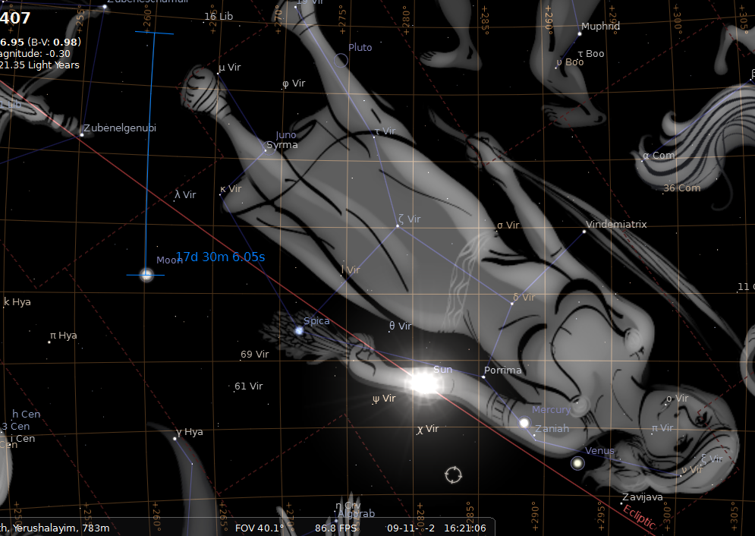
But, Since 3 BC is so close to 2 BC, and since there are so many who think this is the ideal year, I will now show you the 3 BC chart.
Notice that in 3 BC, the moon completely misses being under the feet of Virgo. This is an actual star chart! Do not be deceived by others who make drawings, or who edit the astronomical output of their programs.
In Bullinger’s Witness of the Stars, the left foot is drawn to the star K-Vir, and the right foot to μ-Vir. But the miss is just as complete with the constellation art in Stellarium. The constellation art in Stellarium is likely the most traditional and based on the most ancient renderings.

Slide 5
Also, note that the sun does not seem to be in the most optimal position. It is on the arm here. Someone might accuse me of picking at the details too much, however, it is clear that the moon is a miss, and a clear miss is as good as is a mile. The Almighty expects us to love him with our minds as well as our hearts, and to expect the Scripture to be dead on accurate, and not some sort of fuzzy logic.
So, I have shown the most parsimonious view in the first slides, and the miss in this one, but there are a lot of stubborn traditionalists, and other people who refuse to change when confronted with a little hard evidence. So I will now move on to Luke 3.

Slide 6
Now in the fifteenth year of the reign of Tiberius Caesar, when Pontius Pilate was governor of Judea, and Herod was tetrarch of Galilee, and his brother Philip was tetrarch of the region of Ituraea and Trachonitis, and Lysanias was tetrarch of Abilene, 2 in the high priesthood of Annas and Caiaphas, the word of God came to John, the son of Zacharias, in the wilderness. 3 And he came into all the district around the Jordan, preaching a baptism of repentance for the forgiveness of sins; (Luke 3:1-3).
AD 14
AD 15
AD 16
AD 17
AD 28
AD 29
First, I show the years AD related to the part of Tiberius reign mentioned by Luke. The AD dates and the beginning of Tiberius’ reign are as certain as the dates that American Presidents were inaugurated into office.

Slide 7
Now in the fifteenth year of the reign of Tiberius Caesar, when Pontius Pilate was governor of Judea, and Herod was tetrarch of Galilee, and his brother Philip was tetrarch of the region of Ituraea and Trachonitis, and Lysanias was tetrarch of Abilene, 2 in the high priesthood of Annas and Caiaphas, the word of God came to John, the son of Zacharias, in the wilderness. 3 And he came into all the district around the Jordan, preaching a baptism of repentance for the forgiveness of sins; (Luke 3:1-3).
On August 19, AD 14, Caesar Augustus died. On Sept 17th, AD 14, the Roman Senate declared Tiberius “head of state.”
1 Tiberius
2 Tiberius
3 Tiberius
14 Tiberius
15 Tiberius
AD 14
AD 15
AD 16
AD 17
AD 28
AD 29
First, I show the years AD related to the part of Tiberius reign mentioned by Luke. The AD dates and the beginning of Tiberius’ reign are as certain as the dates that American Presidents were inaugurated into office.

Slide 8
Now in the fifteenth year of the reign of Tiberius Caesar, when Pontius Pilate was governor of Judea, and Herod was tetrarch of Galilee, and his brother Philip was tetrarch of the region of Ituraea and Trachonitis, and Lysanias was tetrarch of Abilene, 2 in the high priesthood of Annas and Caiaphas, the word of God came to John, the son of Zacharias, in the wilderness. 3 And he came into all the district around the Jordan, preaching a baptism of repentance for the forgiveness of sins; (Luke 3:1-3).
On August 19, AD 14, Caesar Augustus died. On Sept 17th, AD 14, the Roman Senate declared Tiberius “head of state.”
1 Tiberius
2 Tiberius
3 Tiberius
14 Tiberius
15 Tiberius
AD 14
AD 15
AD 16
AD 17
AD 28
AD 29
The Numismatic (Coin) evidence shows the reign years of Tiberius only one way. There are many coins, and all the coin experts will say that Tiberius’ years began in August AD 14. The coins were used for everyday commerce, and the most direct way that people came to know how many years the Emperor had ruled. New coins were minted every year.

Slide 9
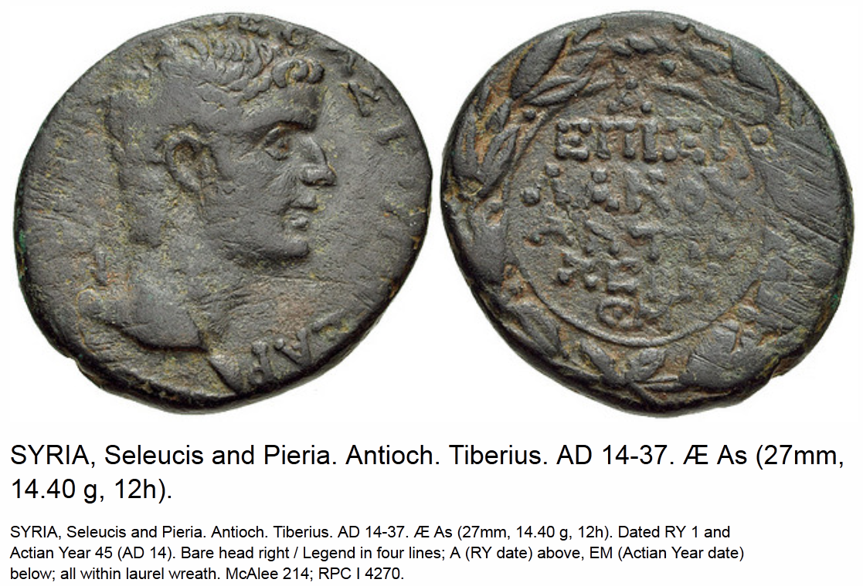
A
Here we have a key Tiberius coin from Antioch, Luke’s home town. The reign year (RY) date is “A” at the top of the coin.
Em
A = regnal year 1, and at the bottom of the coin “EM” is the Latin code for the 45th year of the Actian Era, dating from Sept 31 BC. The year corresponds to AD 14.

Slide 10
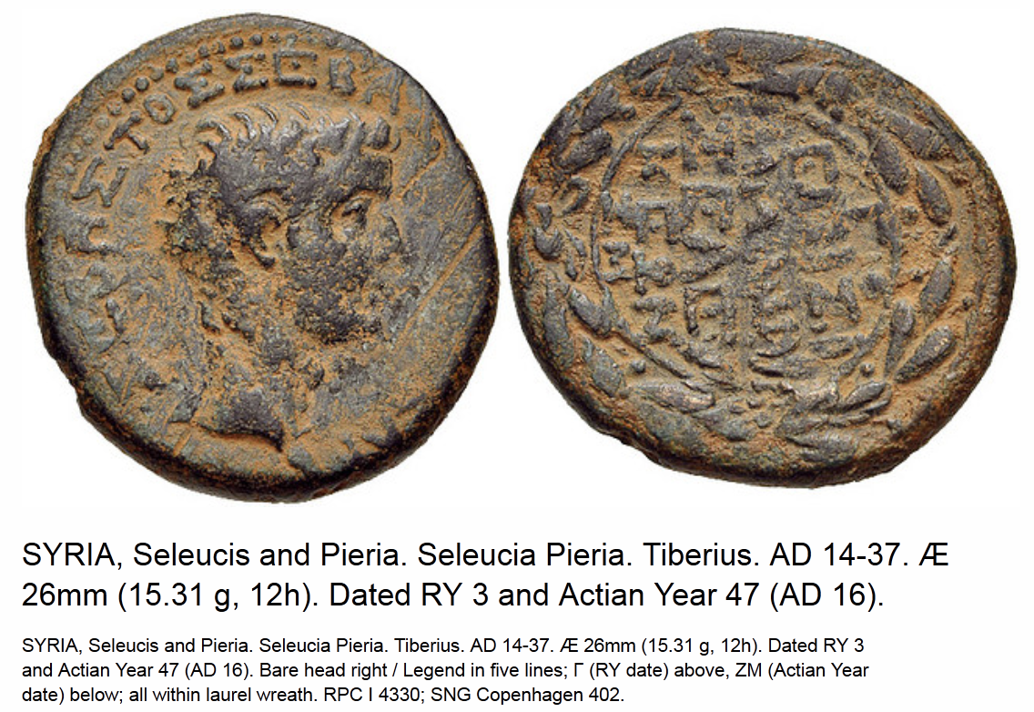

Slide 11
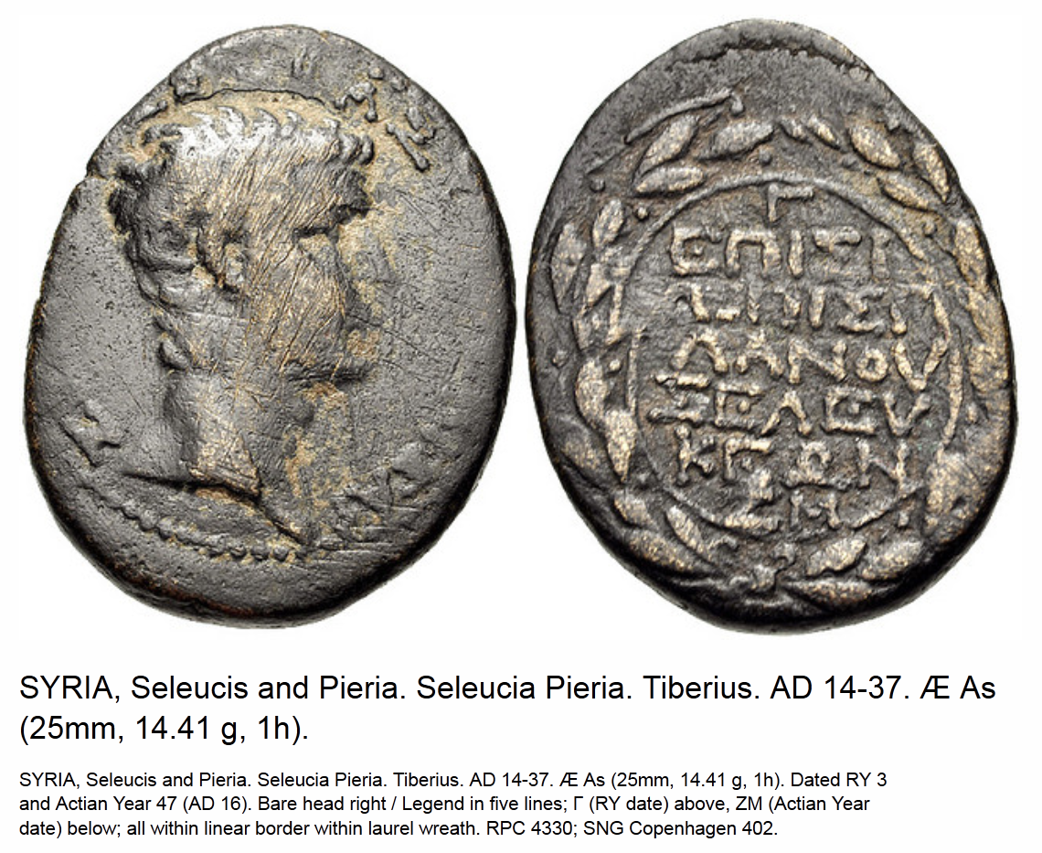
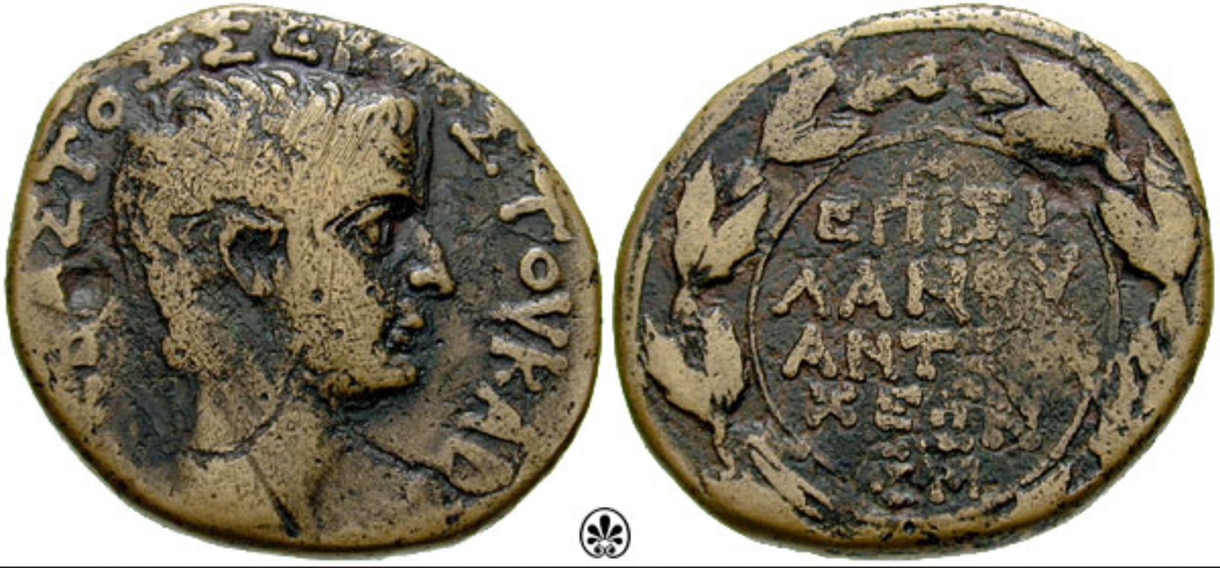
1 Actian
+30
31 Actian
32 Actian
+13
45 Actian
BC 31
-30
BC 1
AD 1
+13
AD 14
Г
A
A fine example, dated year 47 of the Actian Era, corresponding to AD 16 to AD 17, for the third year of Tiberius fall of AD 16 to fall of AD 17.
Em
ZM
This coin is dated the same year, “A” at the top, rubbed out, and “EM” at the bottom, i.e. A = reign year 1, EM = Actian Era 45 = AD 14.
The battle of Actium was in Sept 31 BC. Thus 45 – 31 = 14 AD (Sept).
The 45th year of the Actian Era corresponds to Sept AD 14 to Sept AD 15, which is year 1 of Tiberius.

Slide 12
1 Actian
+30
31 Actian
+14
45 Actian
BC 31
-30
BC 1
+14
AD 14
45 Actian
46 Actian
47 Actian
AD 14
AD 15
AD 16
AD 17
1 Tiberius
2 Tiberius
3 Tiberius

Slide 13
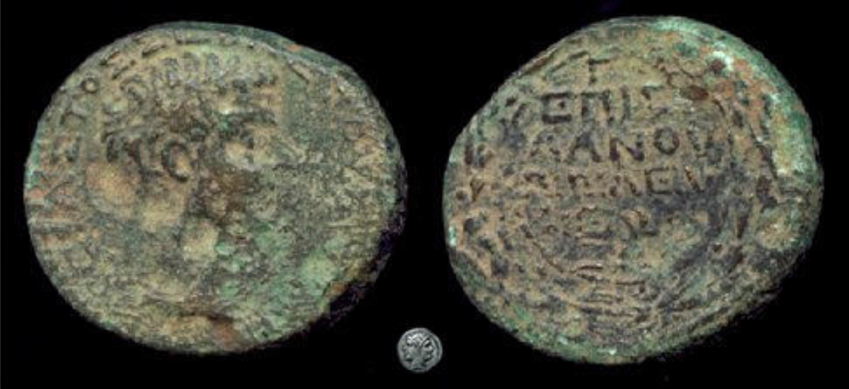

Slide 14
Now in the fifteenth year of the reign of Tiberius Caesar, when Pontius Pilate was governor of Judea, and Herod was tetrarch of Galilee, and his brother Philip was tetrarch of the region of Ituraea and Trachonitis, and Lysanias was tetrarch of Abilene, 2 in the high priesthood of Annas and Caiaphas, the word of God came to John, the son of Zacharias, in the wilderness. 3 And he came into all the district around the Jordan, preaching a baptism of repentance for the forgiveness of sins; (Luke 3:1-3).
On August 19, AD 14, Caesar Augustus died. On Sept 17th, AD 14, the Roman Senate declared Tiberius “head of state.”
1 Tiberius
2 Tiberius
3 Tiberius
14 Tiberius
15 Tiberius
AD 14
AD 15
AD 16
AD 17
AD 28
AD 29
Tiberius’ coins have even been discovered in Antioch, Luke’s home city. They are all dated in just the fashion shown above, each coin being dated according to the years after August, AD 14.

Slide 15
Now in the fifteenth year of the reign of Tiberius Caesar, when Pontius Pilate was governor of Judea, and Herod was tetrarch of Galilee, and his brother Philip was tetrarch of the region of Ituraea and Trachonitis, and Lysanias was tetrarch of Abilene, 2 in the high priesthood of Annas and Caiaphas, the word of God came to John, the son of Zacharias, in the wilderness. 3 And he came into all the district around the Jordan, preaching a baptism of repentance for the forgiveness of sins; (Luke 3:1-3).
On August 19, AD 14, Caesar Augustus died. On Sept 17th, AD 14, the Roman Senate declared Tiberius “head of state.”
The 15th year of Tiberius comes between August AD 28 and August AD 29.
1 Tiberius
2 Tiberius
3 Tiberius
14 Tiberius
15 Tiberius
AD 14
AD 15
AD 16
AD 17
AD 28
AD 29
However, there are those who depend on tradition, or who want to avoid certain unwanted chronological conclusions and the resulting implications for what observances are biblical, and what observances are unscriptural.
They argue that the years of Tiberius are reckoned differently.

Slide 16
Now in the fifteenth year of the reign of Tiberius Caesar, when Pontius Pilate was governor of Judea, and Herod was tetrarch of Galilee, and his brother Philip was tetrarch of the region of Ituraea and Trachonitis, and Lysanias was tetrarch of Abilene, 2 in the high priesthood of Annas and Caiaphas, the word of God came to John, the son of Zacharias, in the wilderness. 3 And he came into all the district around the Jordan, preaching a baptism of repentance for the forgiveness of sins; (Luke 3:1-3).
On October 12, AD 12 Caesar Augustus made Tiberius a “colleague of the empire.”
The 15th year of Tiberius would then come between October 12, AD 26 and October 12 AD 27.
1 Tiberius
2 Tiberius
3 Tiberius
14 Tiberius
15 Tiberius
AD 12
AD 13
AD 14
AD 15
AD 26
AD 27
Others wish to count from a supposed co-regency in AD 12.

Slide 17
Now in the fifteenth year of the reign of Tiberius Caesar, when Pontius Pilate was governor of Judea, and Herod was tetrarch of Galilee, and his brother Philip was tetrarch of the region of Ituraea and Trachonitis, and Lysanias was tetrarch of Abilene, 2 in the high priesthood of Annas and Caiaphas, the word of God came to John, the son of Zacharias, in the wilderness. 3 And he came into all the district around the Jordan, preaching a baptism of repentance for the forgiveness of sins; (Luke 3:1-3).
On October 12, AD 12 Caesar Augustus made Tiberius a “colleague of the empire.”
1 Tiberius
2 Tiberius
3 Tiberius
14 Tiberius
15 Tiberius
AD 12
AD 13
AD 14
AD 15
AD 26
AD 27
But, there is no coin evidence for this. All the existing coins date Tiberius’ reign from AD 14. (There have been attempts at fraud.)
Also, no ancient Roman historian numbers Tiberius’ reign years this way. They all number his years from AD 14.
This contrary reckoning came about only when Church scholars attempted to reconstruct the Chronology of the New Testament using the Church’s assumptions for what it should be. The conclusions derived from Church traditions vs. study of the primary archaeological and historical evidence contradict.

Slide 18
Now in the fifteenth year of the reign of Tiberius Caesar, when Pontius Pilate was governor of Judea, and Herod was tetrarch of Galilee, and his brother Philip was tetrarch of the region of Ituraea and Trachonitis, and Lysanias was tetrarch of Abilene, 2 in the high priesthood of Annas and Caiaphas, the word of God came to John, the son of Zacharias, in the wilderness. 3 And he came into all the district around the Jordan, preaching a baptism of repentance for the forgiveness of sins; (Luke 3:1-3).
On August 19, AD 14, Caesar Augustus died. On Sept 17th, AD 14, the Roman Senate declared Tiberius “head of state.”
The 15th year of Tiberius comes between August AD 28 and August AD 29.
1 Tiberius
2 Tiberius
3 Tiberius
14 Tiberius
15 Tiberius
AD 14
AD 15
AD 16
AD 17
AD 28
AD 29
This is the way the Roman historians and the coin evidence reckons Tiberius’ reign. We expect that when the Scripture uses such an important date that it is well established in history, and this date is well established. The Almighty expects us to love him with our minds, and to believe that which the evidence supports.

Slide 19
Now in the fifteenth year of the reign of Tiberius Caesar, when Pontius Pilate was governor of Judea, and Herod was tetrarch of Galilee, and his brother Philip was tetrarch of the region of Ituraea and Trachonitis, and Lysanias was tetrarch of Abilene, 2 in the high priesthood of Annas and Caiaphas, the word of God came to John, the son of Zacharias, in the wilderness. 3 And he came into all the district around the Jordan, preaching a baptism of repentance for the forgiveness of sins; (Luke 3:1-3).
On August 19, AD 14, Caesar Augustus died. On Sept 17th, AD 14, the Roman Senate declared Tiberius “head of state.”
The 15th year of Tiberius comes between August AD 28 and August AD 29.
1 Tiberius
2 Tiberius
3 Tiberius
14 Tiberius
15 Tiberius
AD 14
AD 15
AD 16
AD 17
AD 28
AD 29
This is the way the Roman historians and the coin evidence reckons Tiberius’ reign. We expect that when the Scripture uses such an important date that it is well established in history, and this date is well established. The Almighty expects us to love him with our minds, and to believe that which the evidence supports.

Slide 20
From thirty years and upward, even to fifty years old, all who enter the service to do the work in the tent of meeting. (Numbers 4:3).
Therefore, we must conclude that John was born in the spring before Yeshua was born in the fall. We also know that John was a Cohen, that is a Levitical Priest of the house of Aaron.
14 Tiberius
15 Tiberius
AD 28
AD 29
We know that Yeshua was born in the fall because this is the only time that the sign in Revelation 12 happens. Even though the sign repeats in some other years than 2 BC, it only repeats in the fall.
While the sign has other meanings, the literal meaning is certainly that the woman is Miraim and that the child she bears is Messiah. The sign correlates with the events in the sky at the time, and with Yahweh’s stated intent that the “lights” serve as signs in Gen. 1:14.
The Scripture tells us that John the Immerser (Baptist) was about 6 months older than Yeshua (not exactly because it took three weeks for Miriam to conceive Messiah). Luke 1:26 tells us that the annunciation to Miryam was in the sixth month of Elizabeth’s pregnancy with John.

Slide 21
From thirty years and upward, even to fifty years old, all who enter the service to do the work in the tent of meeting. (Numbers 4:3).
So John could not have begun his ministry in AD 28, because the spring of that year occurs before Tiberius’ 15th year.
14 Tiberius
15 Tiberius
AD 28
AD 29
The Scriptural precedent is that a cohen starts their service at age 30, that is unless they are the high priest, and then it is when his father dies, or he gets replaced for political reasons. John was not the high priest, so we may assume that if Luke says Yeshua was “about 30” that John was certainly already 30 when he began his ministry.

Slide 22
And the child continued to grow, and to become strong in spirit, and he lived in the deserts until the day of his public appearance to Israel. (Luke 1:80).
The Greek word translated “public appearance” (ἀναδείξεως) [anadeikseos] means “commissioning” or “installment” (BDAG ) or “inaguration” (Thayer).
15 Tiberius
AD 29
Luke 1:80 says “until the day of his public appearance to Israel.” These words apply to John the Immerser, who was a Cohen. What do they mean chronologically?

Slide 23
And Yeshua himself began to be about thirty years of age (Luke 3:23).
15 Tiberius
AD 29
There are some variants on this text, some texts suggesting Yeshua was just a little over 30 and some texts suggesting he was just a little under 30 when he began his ministry. If John reached the ordination age in the 15th year of Tiberius in the spring, then Yeshua’s 30th year would begin on Tishri 1. I prefer the texts that read “about 30” and interpret them as “almost” 30 because Yeshua’s immersion and temptation were preparations for his ministry. Thus, Yeshua was “almost 30” a short time before Tishri 1 AD 29.

Slide 24
Inasmuch as many have undertaken to compile an account of the things accomplished among us, 2 just as those who from the beginning were eyewitnesses and servants of the word have handed them down to us, 3 it seemed fitting for me as well, having investigated everything carefully from the beginning, to write it out for you in consecutive order, most excellent Theophilus; (Luke 1:1-3).
15 Tiberius
AD 29
There are many who do not like these straightforward explanations. They wish that when Luke says “about 30” that he is making a guess, as if he does not know the exact answer. Is Luke expressing ignorance or does Luke simply know he is close to 30 (but not quite), and therefore cannot tell us he is 30, so he says “about 30” to be completely truthful?

Slide 25
Inasmuch as many have undertaken to compile an account of the things accomplished among us, 2 just as those who from the beginning were eyewitnesses and servants of the word have handed them down to us, 3 it seemed fitting for me as well, having investigated everything carefully from the beginning, to write it out for you in consecutive order, most excellent Theophilus; (Luke 1:1-3).
15 Tiberius
AD 29
Luke says he gathered his information from eyewitnesses. The detail in Luke 1 means that he surely interviewed Miryam herself. Every detail that could be known about Messiah would be known and related. Luke says “many have undertaken to compile an account.” So his was not the only one, neither were Matthew or Mark the only accounts (John was written later). The most basic biography of a person is when they were born. Luke knew this information. Scripture regularly reports the birth year and ages of many men, who are below Messiah.
So the question is, how ignorant do people want to suppose Luke was?
I don’t believe Luke was ignorant. There is no guessing on his part. He is just being fully truthful, and is reporting Messiah’s age in a literary fashion connecting it to the start of his ministry at age 30, which is the proper point for immersion and ordination.

Slide 26
We will now see why Yeshua’s age “about 30” after John’s ordination at age 30 in the 15th year of Tiberius is so important:
Birth of Yeshua
He becomes age 1
He becomes age 30
15th
0
1
2
3
3 + 24 = 27
27
28
29
30
2 BC
1 BC
1
2
2 + 24 = 26
26
27
28
29 AD
“about 30”
Notice that the AD (Anno Domini) era is as right as it can be given the starting point of the Roman year. To obtain Yeshua’s age from the Roman year, “on Tishri 1 add 1.”

Slide 27
Some chronologists are bound and determined to mess up a very simple explanation. They want to shift Yeshua’s birth back to 3 BC. Then John’s birth has to be put back to 3 BC also. But now observe that John reaches his 30th year (when he should be ordained) in the 14th year of Tiberius instead of the 15th:
Tiberius
14th
15th
0
1
2
3
John’s Age
27
28
29
30
0
1
2
3
Yeshua’s Age
27
28
29
30
3 BC
2 BC
1 BC
1
2
BC/AD system
26
27
28
29 AD

Slide 28
To fix this problem they change Tiberius’ reign like this:
Tiberius
14th
15th
0
1
2
3
John’s Age
27
28
29
30
0
1
2
3
Yeshua’s Age
27
28
29
30
3 BC
2 BC
1 BC
1
2
BC/AD system
26
27
28
29 AD
But, there is no coin evidence for this reckoning. There is no inscription evidence for it. And no contemporary Roman historian dated this way.
There are two tricks they use to pull this off. Some tell us that the Jewish method of reckoning is to use a non-accession method of dating so that they can back date Tiberius 1st year to AD 13 and count his 2nd year after Tishri 1, AD 14.
Others tell us that Luke used the Syrio-Macedonian Calendar the same way, but counting year 1 before October AD 14, and year 2 after October AD 14.

Slide 29
The black arrow is Tishri 1, and the red one when Augustus died, and Tiberius became unofficial ruler. After Tishri 1, the Roman Senate made him “head of state.”
1 Tiberius
2 Tiberius
3 Tiberius
14 Tiberius
15 Tiberius
AD 14
AD 15
AD 16
AD 17
AD 28
AD 29
1 Tiberius
2 Tiberius
3 Tiberius
14 Tiberius
15 Tiberius
AD 14
AD 15
AD 16
AD 17
AD 27
AD 28
AD 29
Is it normal for the Jews to count according to the second scheme? NO, not at all. A study of Jewish kings will show that the normal mode of reckoning was the “accession year method.” In this method, when the outgoing ruler dies, the incoming ruler does not count that same year as year 1. Instead the new ruler only counts this year as his “accession year,” and the next year counts as year 1. Thus, the part of Tiberius year before Tishri 1 would not be counted as a whole year. To use the Jewish method, only the year after Tishri 1 is counted as year 1.
Also, we may ask, would the Jews reckon the Roman Emperors years in a manner that is inconsistent with when the Romans count them, and inconsistent with the coins that the Romans trade with them?

Slide 30
The bottom scheme does not agree with normal Jewish methods. What about the Syrio-Macedonian Calendar? Would Luke, a Jewish Convert, even bother with a calendar that is not the Scriptural one, whose new year day was in October? Hardly! But again, it is an assumption to say this calendar was used backdated, when it can be used more consistently with the accession year method.
1 Tiberius
2 Tiberius
3 Tiberius
14 Tiberius
15 Tiberius
AD 14
AD 15
AD 16
AD 17
AD 28
AD 29
1 Tiberius
2 Tiberius
3 Tiberius
14 Tiberius
15 Tiberius
AD 14
AD 15
AD 16
AD 17
AD 27
AD 28
AD 29
There are dozen more schemes that are proposed to get John the Immerser and Messiah’s 30th years to commence earlier than AD 29 by moving Tiberius 15th year back. All of these methods contradict the accepted norms. They contradict the very Roman coins that Jews used every day.
These schemes were invented to avoid unwanted conclusions about the times and seasons taught be Scripture that we should observe. And then once they were accepted other parts of chronology were bent and broken to fit the schemes.

Slide 31
The birth date of Messiah is Tishri 1, 2 BC. This correlates perfectly with the sign of the Virgin in Rev. 12:1-2, and with Luke 3:1, 23.
Birth of Yeshua
He becomes age 1
He becomes age 30
15th
0
1
2
3
3 + 24 = 27
27
28
29
30
2 BC
1 BC
1
2
2 + 24 = 26
26
27
28
29 AD
“about 30”
Notice that the AD (Anno Domini) era is as right as it can be given the starting point of the Roman year. To obtain Yeshua’s age from the Roman year, “on Tishri 1 add 1.”

Slide 32
The Year and Day of Messiah’s Birth
My approach here is to explain the chronology so that those contrary views that lie closest to the truth, but which nevertheless result in conclusions which contradict it are addressed first. The 3 BC theory lies closest to the 2 BC truth.
In the next segment I will show how the priestly rotation of 24 courses agrees with the 2 BC birth on Tishri 1, but does not fit well with the 3 BC theory.

Slide 33
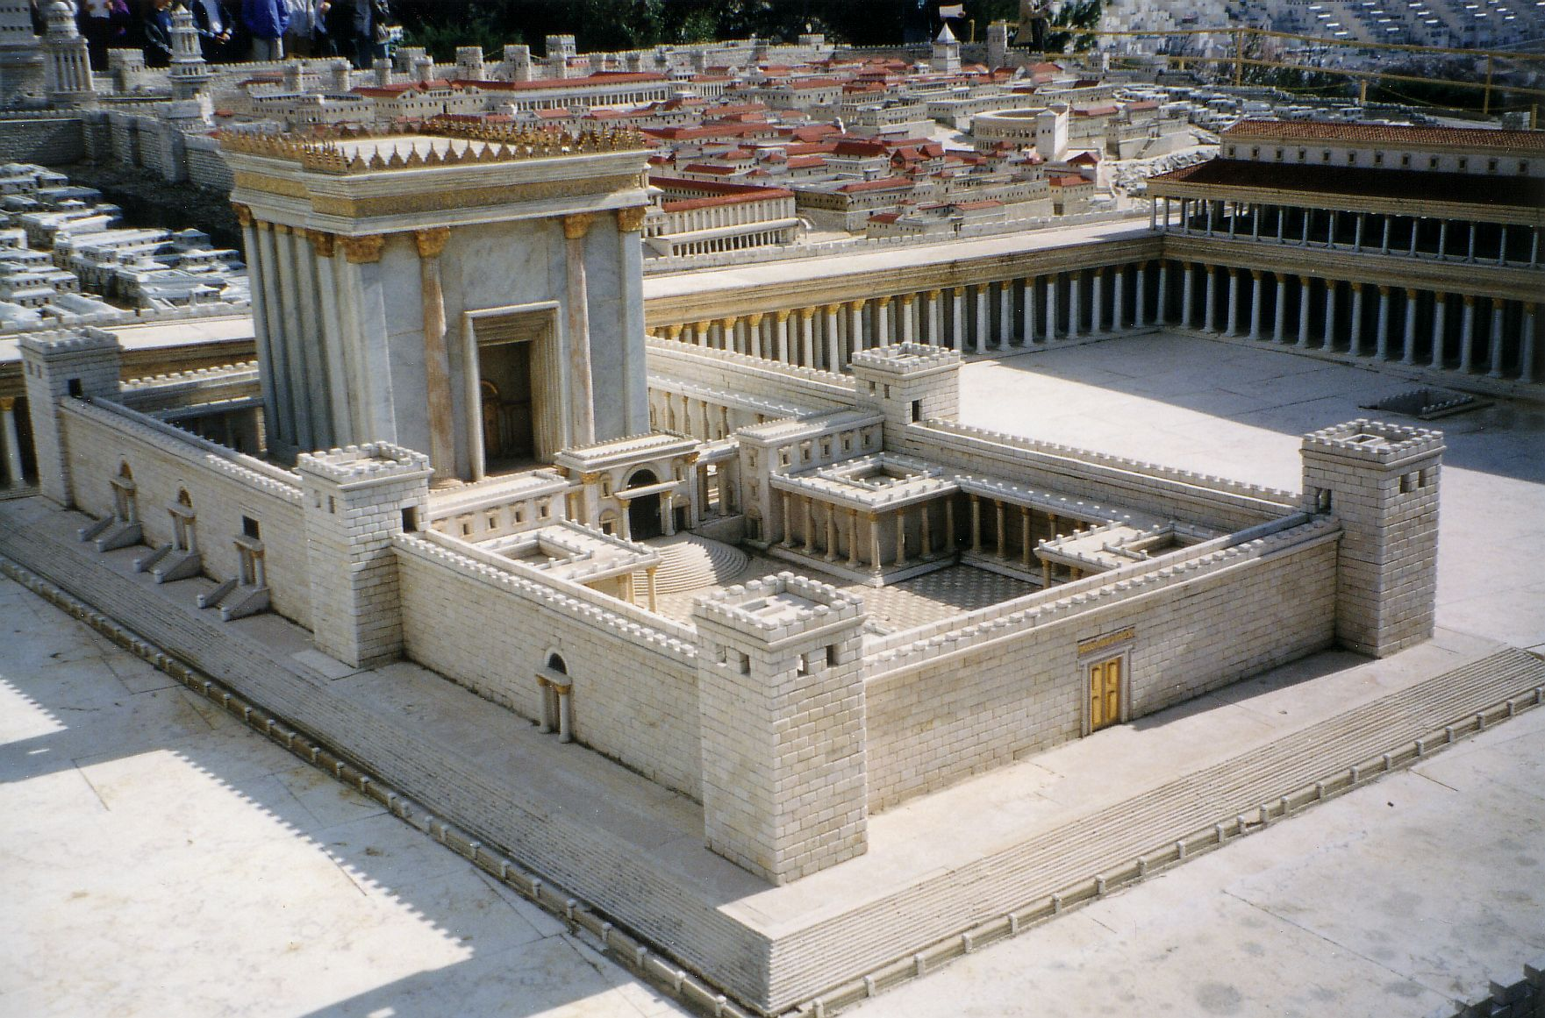
In the time of King David there were 24 priestly rotations established to serve in the Temple. They would serve for one week each, coming on duty on the Sabbath, and going off duty on the next Sabbath. The next priestly division would begin their duties by noon on the Sabbath.
In the past, scholars have wrongly assumed that these rotations began on the Sabbath before Nisan 1. Also, in the past scholars have wrongly assumed that the priestly rotations were suspended during the major Jewish feast weeks.

Slide 34

Careful attention to the most ancient sources will show that the priestly courses began on the Sabbath before Tishri 1, and that when a feast week came, the course on duty was joined by all the other courses. However, the other courses did not interrupt the regular rotation of divisions. These conclusions are explained in detail by Roger T. Beckwith, “The Courses of the Priests,” pg. 79-92.

Slide 35
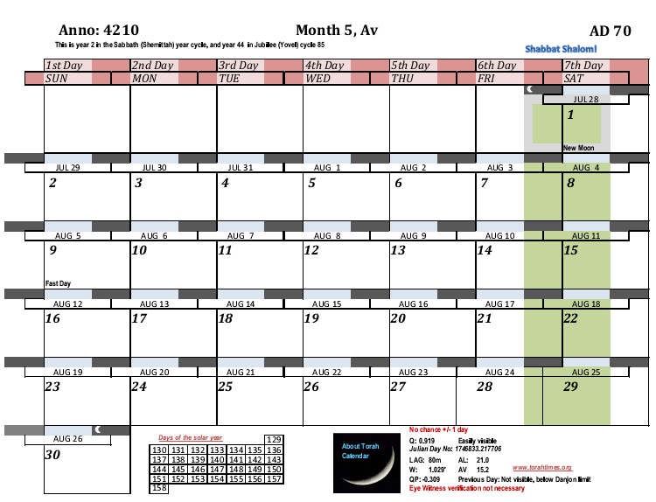
Rabbi Yose Ben Halaphta said, “the course of Jehoiarib was on duty on Ab 9” “on Sunday” for the year that the second temple was destroyed. Ab 9 fell on Sunday in AD 70, and could not have been on Sunday in AD 69.
So in AD 70 the 24th course finished on Av 8 and the 1st course began again. I now count backwards to find out who was serving on the Sabbath before Aviv/Nisan 1.
Order of the
divisions,
Jehoiarib
Jedaiah
Harim
Seorim
Malchijah
Mijamin
Hakkoz
8. Abijah
9. Jeshua
10. Shecaniah
11. Eliashib
12. Jakim
13. Huppah
14. Jeshebeab
15. Bilgah
16. Immer
17. Hezir
18. Happizzez
19. Pethahiah
20. Jehezkel
21. Jachin
22. Gamul
23. Delaiah
24. Maaziah
4209
23. Delaiah
24. Maaziah
1. Jehoiarib

Slide 36
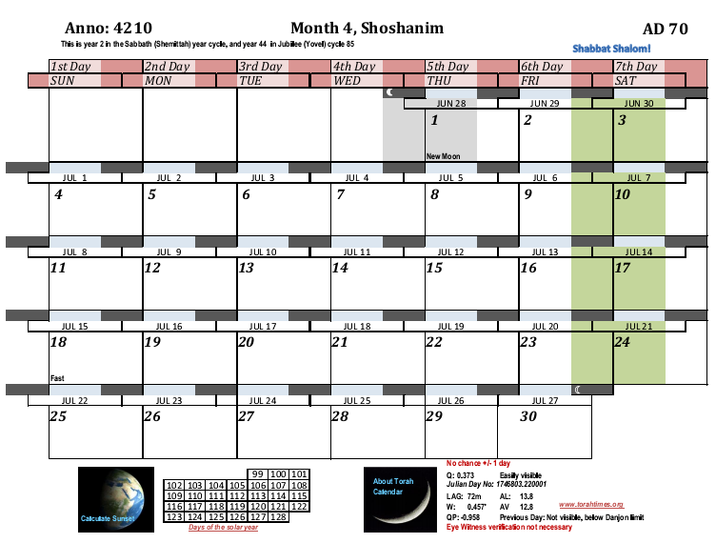
Rabbi Yose Ben Halaphta said, “the course of Jehoiarib was on duty on Ab 9” for the year that the second temple was destroyed.
Order of the
divisions,
Jehoiarib
Jedaiah
Harim
Seorim
Malchijah
Mijamin
Hakkoz
8. Abijah
9. Jeshua
10. Shecaniah
11. Eliashib
12. Jakim
13. Huppah
14. Jeshebeab
15. Bilgah
16. Immer
17. Hezir
18. Happizzez
19. Pethahiah
20. Jehezkel
21. Jachin
22. Gamul
23. Delaiah
24. Maaziah
4209
19. Pethahiah
23. Delaiah
20. Jehezkel
24. Maaziah
21. Jachin
1. Jehoiarib
22. Gamul
23. Delaiah

Slide 37
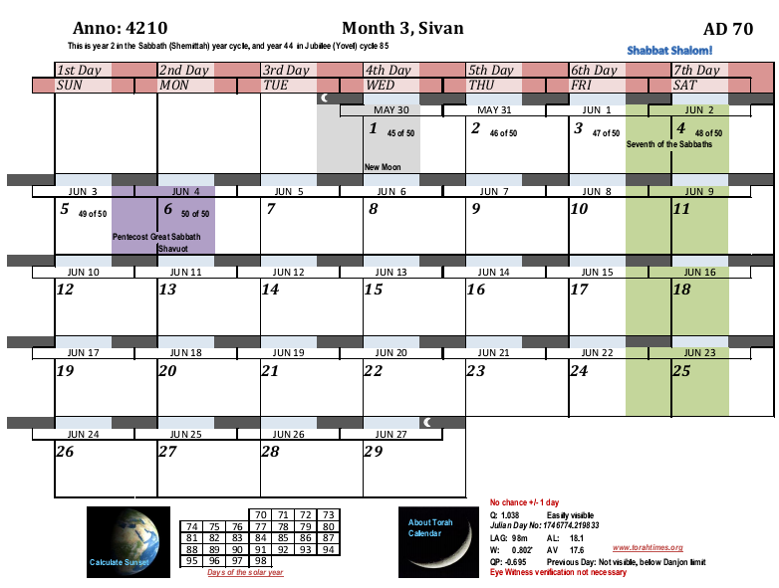
Rabbi Yose Ben Halaphta said, “the course of Jehoiarib was on duty on Ab 9” for the year that the second temple was destroyed.
Order of the
divisions,
Jehoiarib
Jedaiah
Harim
Seorim
Malchijah
Mijamin
Hakkoz
8. Abijah
9. Jeshua
10. Shecaniah
11. Eliashib
12. Jakim
13. Huppah
14. Jeshebeab
15. Bilgah
16. Immer
17. Hezir
18. Happizzez
19. Pethahiah
20. Jehezkel
21. Jachin
22. Gamul
23. Delaiah
24. Maaziah
4209
15. Bilgah
16. Immer
17. Hezir
18. Happizzez
19. Pethahiah

Slide 38
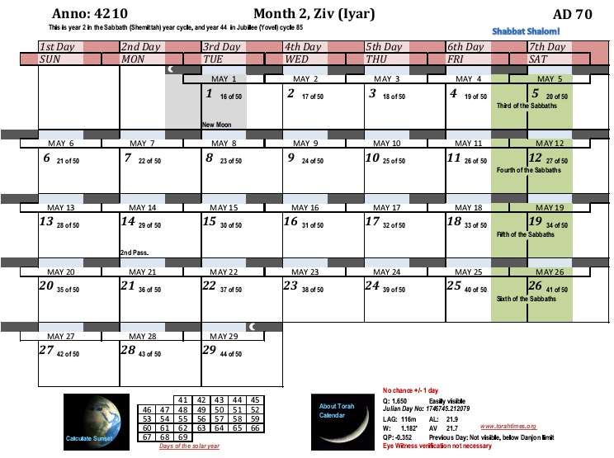
Rabbi Yose Ben Halaphta said, “the course of Jehoiarib was on duty on Ab 9” for the year that the second temple was destroyed.
Order of the
divisions,
Jehoiarib
Jedaiah
Harim
Seorim
Malchijah
Mijamin
Hakkoz
8. Abijah
9. Jeshua
10. Shecaniah
11. Eliashib
12. Jakim
13. Huppah
14. Jeshebeab
15. Bilgah
16. Immer
17. Hezir
18. Happizzez
19. Pethahiah
20. Jehezkel
21. Jachin
22. Gamul
23. Delaiah
24. Maaziah
4209
11. Eliashib
12. Jakim
13. Huppah
14. Jeshebeab
15. Bilgah

Slide 39
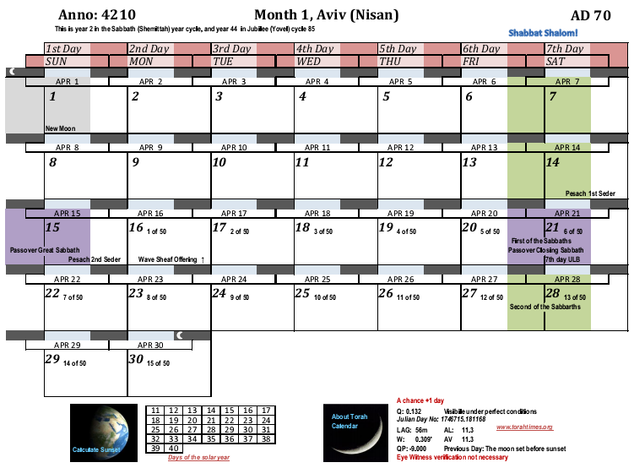
Rabbi Yose Ben Halaphta said, “the course of Jehoiarib was on duty on Ab 9” for the year that the second temple was destroyed.
It is obvious that the first course does not start on the Sabbath before Nisan 1 here!
Order of the
divisions,
1. Jehoiarib
2. Jedaiah
3. Harim
4. Seorim
5. Malchijah
6. Mijamin
7. Hakkoz
8. Abijah
9. Jeshua
10. Shecaniah
11. Eliashib
12. Jakim
13. Huppah
14. Jeshebeab
15. Bilgah
16. Immer
17. Hezir
18. Happizzez
19. Pethahiah
20. Jehezkel
21. Jachin
22. Gamul
23. Delaiah
24. Maaziah
4209
7. Hakkoz
8. Abijah
Since the cycle does not start with Nisan, we now have to check to see if it starts with the Sabbath before Tishri 1.
9. Jeshua
10. Shecaniah
11. Eliashib

Slide 40
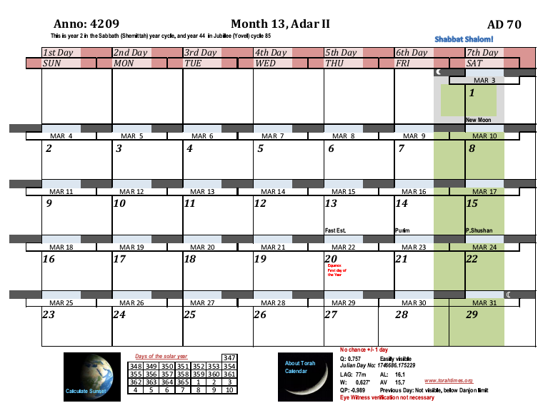
Rabbi Yose Ben Halaphta said, “the course of Jehoiarib was on duty on Ab 9” for the year that the second temple was destroyed.
O.k., Let’s keep cycling backward!
Order of the
divisions,
1. Jehoiarib
2. Jedaiah
3. Harim
4. Seorim
5. Malchijah
6. Mijamin
7. Hakkoz
8. Abijah
9. Jeshua
10. Shecaniah
11. Eliashib
12. Jakim
13. Huppah
14. Jeshebeab
15. Bilgah
16. Immer
17. Hezir
18. Happizzez
19. Pethahiah
20. Jehezkel
21. Jachin
22. Gamul
23. Delaiah
24. Maaziah
4208
2. Jedaiah
3. Harim
4. Seorim
5. Malchijah
6. Mijamin
7. Hakkoz

Slide 41
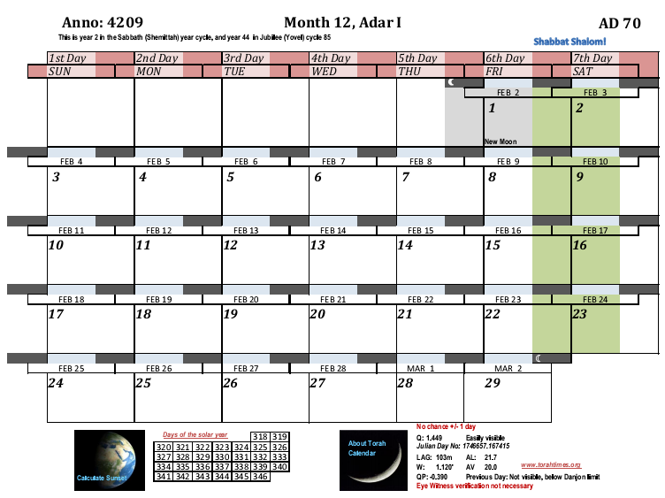
Rabbi Yose Ben Halaphta said, “the course of Jehoiarib was on duty on Ab 9” for the year that the second temple was destroyed.
Order of the
divisions,
1. Jehoiarib
2. Jedaiah
3. Harim
4. Seorim
5. Malchijah
6. Mijamin
7. Hakkoz
8. Abijah
9. Jeshua
10. Shecaniah
11. Eliashib
12. Jakim
13. Huppah
14. Jeshebeab
15. Bilgah
16. Immer
17. Hezir
18. Happizzez
19. Pethahiah
20. Jehezkel
21. Jachin
22. Gamul
23. Delaiah
24. Maaziah
4208
22. Gamul
Due to the number of weeks in a year (52 or more) and the fact there are only 24 courses means that the first course always serves 3 times, but most of them only serve twice.
23. Delaiah
24. Maaziah
1. Jehoiarib
2. Jedaiah

Slide 42
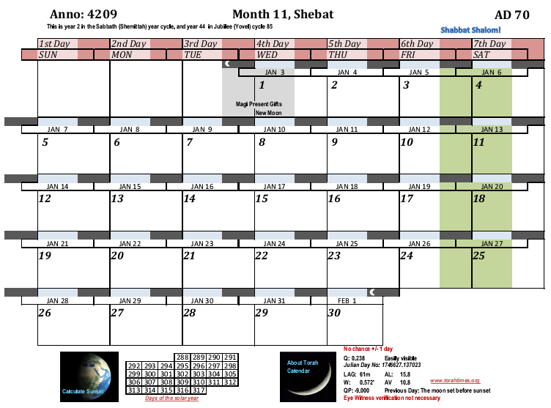
Rabbi Yose Ben Halaphta said, “the course of Jehoiarib was on duty on Ab 9” for the year that the second temple was destroyed.
Order of the
divisions,
1. Jehoiarib
2. Jedaiah
3. Harim
4. Seorim
5. Malchijah
6. Mijamin
7. Hakkoz
8. Abijah
9. Jeshua
10. Shecaniah
11. Eliashib
12. Jakim
13. Huppah
14. Jeshebeab
15. Bilgah
16. Immer
17. Hezir
18. Happizzez
19. Pethahiah
20. Jehezkel
21. Jachin
22. Gamul
23. Delaiah
24. Maaziah
4208
18. Happizzez
19. Pethahiah
20. Jehezkel
21. Jachin
22. Gamul

Slide 43
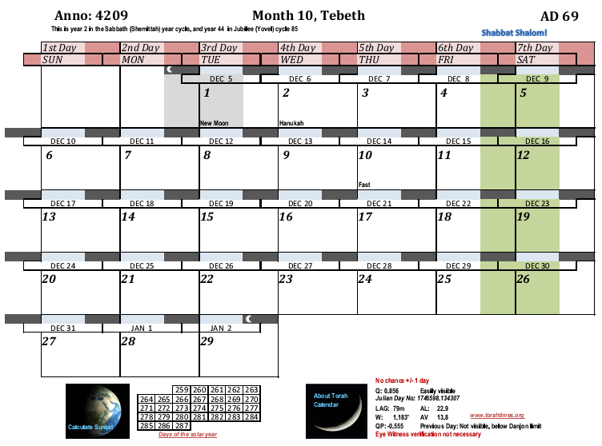
Rabbi Yose Ben Halaphta said, “the course of Jehoiarib was on duty on Ab 9” for the year that the second temple was destroyed.
Order of the
divisions,
1. Jehoiarib
2. Jedaiah
3. Harim
4. Seorim
5. Malchijah
6. Mijamin
7. Hakkoz
8. Abijah
9. Jeshua
10. Shecaniah
11. Eliashib
12. Jakim
13. Huppah
14. Jeshebeab
15. Bilgah
16. Immer
17. Hezir
18. Happizzez
19. Pethahiah
20. Jehezkel
21. Jachin
22. Gamul
23. Delaiah
24. Maaziah
4208
14. Jeshebeab
15. Bilgah
16. Immer
17. Hezir
18. Happizzez

Slide 44
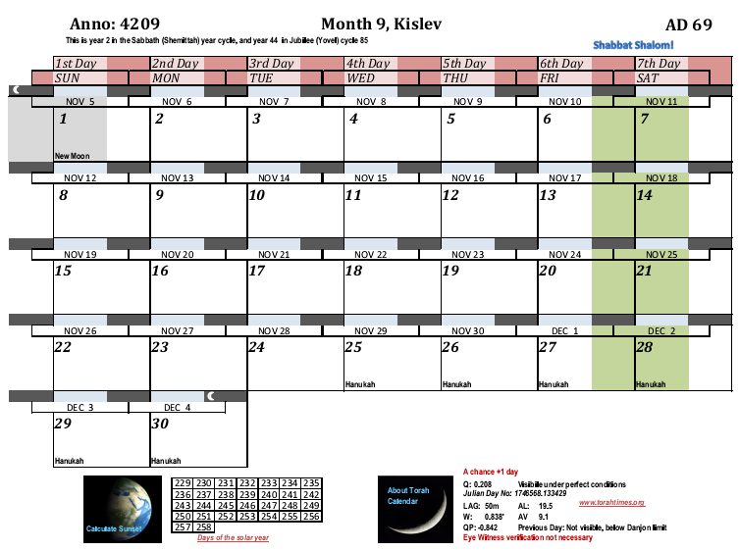
Rabbi Yose Ben Halaphta said, “the course of Jehoiarib was on duty on Ab 9” for the year that the second temple was destroyed.
Order of the
divisions,
1. Jehoiarib
2. Jedaiah
3. Harim
4. Seorim
5. Malchijah
6. Mijamin
7. Hakkoz
8. Abijah
9. Jeshua
10. Shecaniah
11. Eliashib
12. Jakim
13. Huppah
14. Jeshebeab
15. Bilgah
16. Immer
17. Hezir
18. Happizzez
19. Pethahiah
20. Jehezkel
21. Jachin
22. Gamul
23. Delaiah
24. Maaziah
4208
10. Shecaniah
11. Eliashib
12. Jakim
13. Huppah
14. Jeshebeab

Slide 45
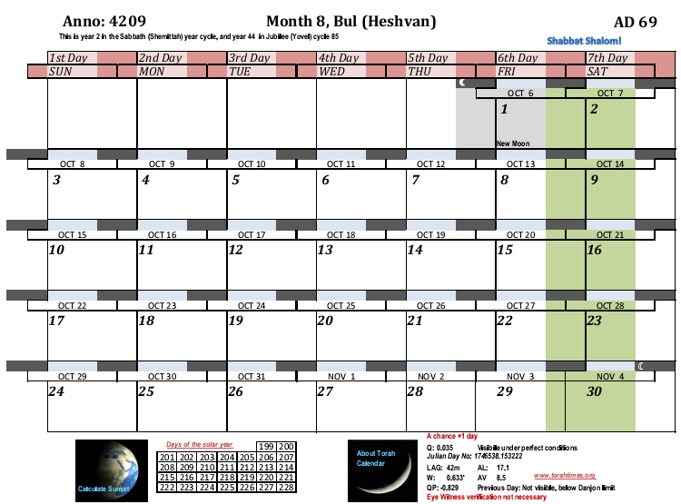
Rabbi Yose Ben Halaphta said, “the course of Jehoiarib was on duty on Ab 9” for the year that the second temple was destroyed.
Order of the
divisions,
1. Jehoiarib
2. Jedaiah
3. Harim
4. Seorim
5. Malchijah
6. Mijamin
7. Hakkoz
8. Abijah
9. Jeshua
10. Shecaniah
11. Eliashib
12. Jakim
13. Huppah
14. Jeshebeab
15. Bilgah
16. Immer
17. Hezir
18. Happizzez
19. Pethahiah
20. Jehezkel
21. Jachin
22. Gamul
23. Delaiah
24. Maaziah
4208
Notice that Abijah has its first service here. All divisions have at least two services per year. We know that John the Immerser was conceived after the second service, and not the first service. This is because John’s birth is linked to Yeshua’s birth in the fall by the Revelation sign and the fact that he was half a year older than Messiah.
5. Malchijah
6. Mijamin
7. Hakkoz
8. Abijah
9. Jeshua
10. Shecaniah

Slide 46
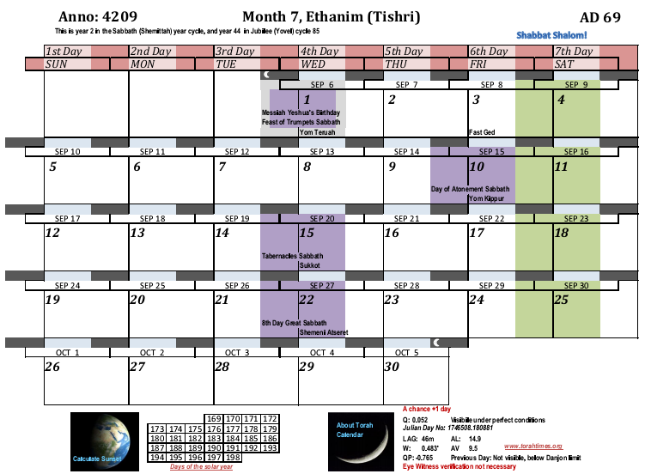
Rabbi Yose Ben Halaphta said, “the course of Jehoiarib was on duty on Ab 9” for the year that the second temple was destroyed.
Order of the
divisions,
1. Jehoiarib
2. Jedaiah
3. Harim
4. Seorim
5. Malchijah
6. Mijamin
7. Hakkoz
8. Abijah
9. Jeshua
10. Shecaniah
11. Eliashib
12. Jakim
13. Huppah
14. Jeshebeab
15. Bilgah
16. Immer
17. Hezir
18. Happizzez
19. Pethahiah
20. Jehezkel
21. Jachin
22. Gamul
23. Delaiah
24. Maaziah
4208
1. Jehoiarib
2. Jedaiah
We now see that Jehoiarib’s duty began on the Sabbath before Tishri 1, confirming that the priestly divisions began their rotations at this point.
3. Harim
4. Seorim
5. Malchijah

Slide 47
Order of the
divisions,
1. Jehoiarib
2. Jedaiah
3. Harim
4. Seorim
5. Malchijah
6. Mijamin
7. Hakkoz
8. Abijah
9. Jeshua
10. Shecaniah
11. Eliashib
12. Jakim
13. Huppah
14. Jeshebeab
15. Bilgah
16. Immer
17. Hezir
18. Happizzez
19. Pethahiah
20. Jehezkel
21. Jachin
22. Gamul
23. Delaiah
24. Maaziah
Even supposing the Rabbi was smart enough to dig back into history to calculate the matter, to the Jews his statement the same as saying the priestly courses begin in Tishri. For it is obvious that counting backward from Av 9 for course 1 does not put the first course in Nisan!
The Qumran cult also began the priestly divisions with Tishri at the beginning of their cycles. What you have seen here is an astronomical demonstration of the truth of Rabbi Halaphta’s statement that the course of Jehoiarib was on duty on Av 9, the first day of the week, in AD 70, the year when the second temple was destroyed.
The Rabbi could not have guessed. He would have to know that Av 9 was a Sunday. There is a 1/7 chance of guessing this. He would have to know that the year was leap year. There was only a 1/3 chance of guessing this. He misleads us in Seder Olam that the year of the destruction is AD 69 (so he can synchronize it with the Sabbatical year for his Daniel 9 heresy), but in this case he gives us correct information for the actual year of the destruction AD 70.

Slide 48
Order of the
divisions,
1. Jehoiarib
2. Jedaiah
3. Harim
4. Seorim
5. Malchijah
6. Mijamin
7. Hakkoz
8. Abijah
9. Jeshua
10. Shecaniah
11. Eliashib
12. Jakim
13. Huppah
14. Jeshebeab
15. Bilgah
16. Immer
17. Hezir
18. Happizzez
19. Pethahiah
20. Jehezkel
21. Jachin
22. Gamul
23. Delaiah
24. Maaziah
Further, we see that the synchronization of courses only works if the Passover festival in AD 70, and the Tabernacles festival in AD 69 does NOT interrupt the regular order of the divisions. Others have suggested that the festival weeks pushed the timing of the divisions forward by skipping festival weeks. In some cases this is up to three weeks! They do this because their chronological theories of Messiah’s birth require it!
However, since the feasts do not synchronize with the week, such a suggestion leads to a chaotic scheduling problem of what to do with the divisions whose service is interrupted at half a week. It is plainly evident that quitting in the middle of a week makes no sense. The duties of the regular divisions were scheduled weekly because of weekly Sabbath offerings.
The other courses only joined them to carry out the extra offerings of the feast days and the extra work. The regular division carried on with the regular weekly services.
To think otherwise is not to serve the Almighty with out minds. And it is also to suppose that the priests, who are supposed to show forth knowledge, were brainless idiots when it came to orderly schedules.

Slide 49
Order of the
divisions,
1. Jehoiarib
2. Jedaiah
3. Harim
4. Seorim
5. Malchijah
6. Mijamin
7. Hakkoz
8. Abijah
9. Jeshua
10. Shecaniah
11. Eliashib
12. Jakim
13. Huppah
14. Jeshebeab
15. Bilgah
16. Immer
17. Hezir
18. Happizzez
19. Pethahiah
20. Jehezkel
21. Jachin
22. Gamul
23. Delaiah
24. Maaziah
Now we will take this bit of information and show that starting the courses the Sabbath before Tishri 1 greatly favors 2 BC over 3 BC. I will suppose here that Messiah was born in 3 BC, and then will show by consequence of this 3 BC supposition that an unreasonable situation results. We will use as many time gaps as are reasonable between annunciations and the respective conceptions of Yochannan Ha Matbil and Yeshua, and we will see that our NULL hypothesis has too much extra time. To keep the file size down, we have to proceed to Part II of the Birth of Yeshua.

