Slide 1
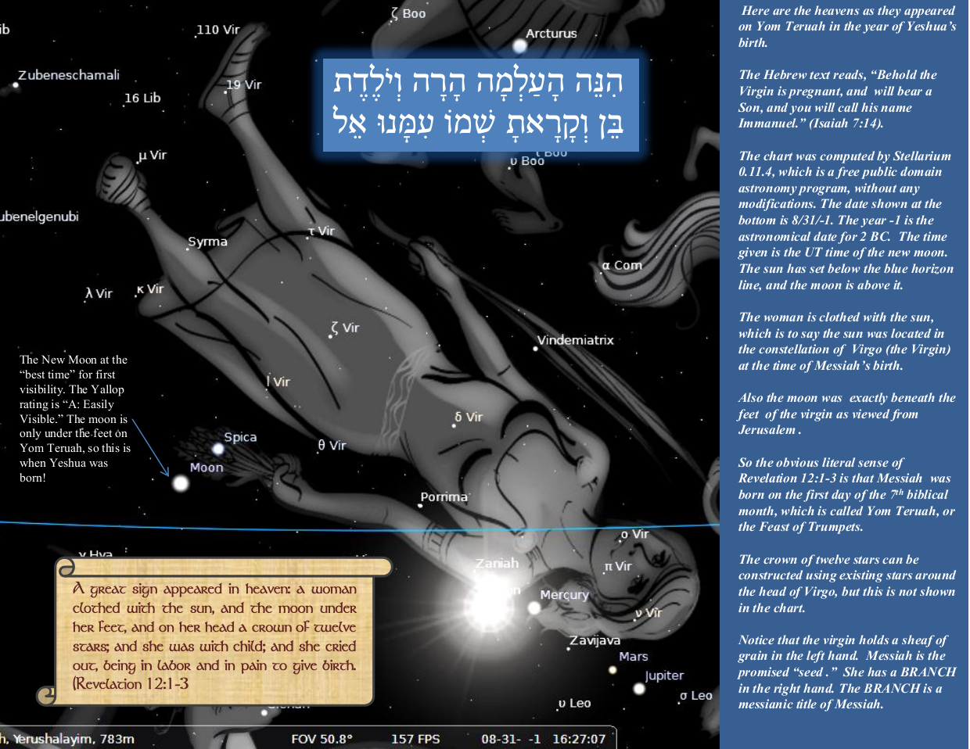
This presentation will show you how to use our calendar charts to determine the biblical set times.
The presentation begins on slide 3. This and the next side are simply to clue the viewer in on how important the biblical calendar is to understanding Scripture.
In the last few slides, I return to the topic of these two slides.

Slide 2
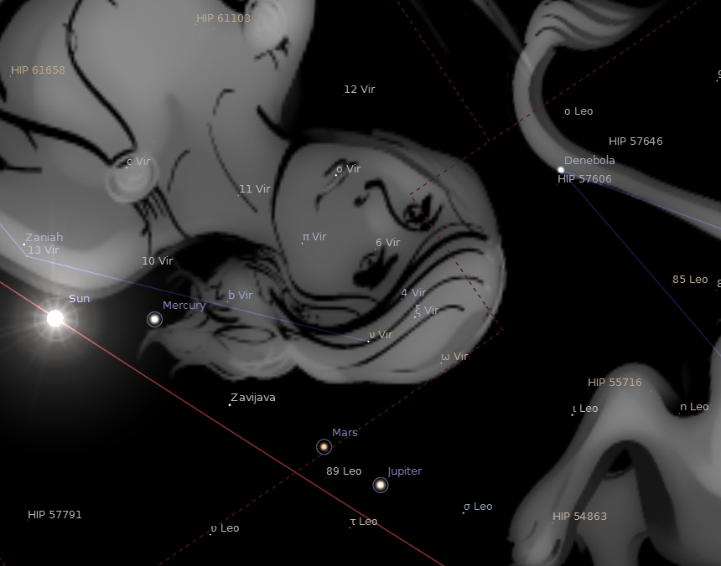
בַּחֹדֶשׁ הַשְּׁבִיעִי בְּאֶחָד לַחֹדֶשׁ יִהיֶה לָכֶם שַׁבָּתוֹן זִכרוֹן תְּרוּעָה מִקרָא־קֹדֶשׁ
12
Reuben
Simeon
11
10
Levi
Judah
9
1
“And on her head a crown of twelve stars” (Revelation 12:1). Shown here are twelve naked eye visible stars (mag 6.0 or less) . They are displayed in the free public domain program called Stellarium. The actual stars are highlighted with red circles and counted in the blue stars. I have put in the twelve tribes of Israel from the list in Revelation 7. The date is 8/31/ 2 BC when Messiah was born. Off the screen to the left is the new moon of Tishri 1. Present for Messiah’s birth are also, the Sun, Mercury, Mars, Jupiter, and Venus (which is 10 degrees below Jupiter off the screen). Jupiter is considered the “Tzedeq” Star, or Messiah star. As in Joseph’s dream, the other stars are bowing down to it.
Ephraim/Joseph
Benjamin
8
2
7
Manasseh
Naphtali
3
Gad
www.torahtimes.org
6
Zebulun
4
5
Isaachar
Asher

Slide 3
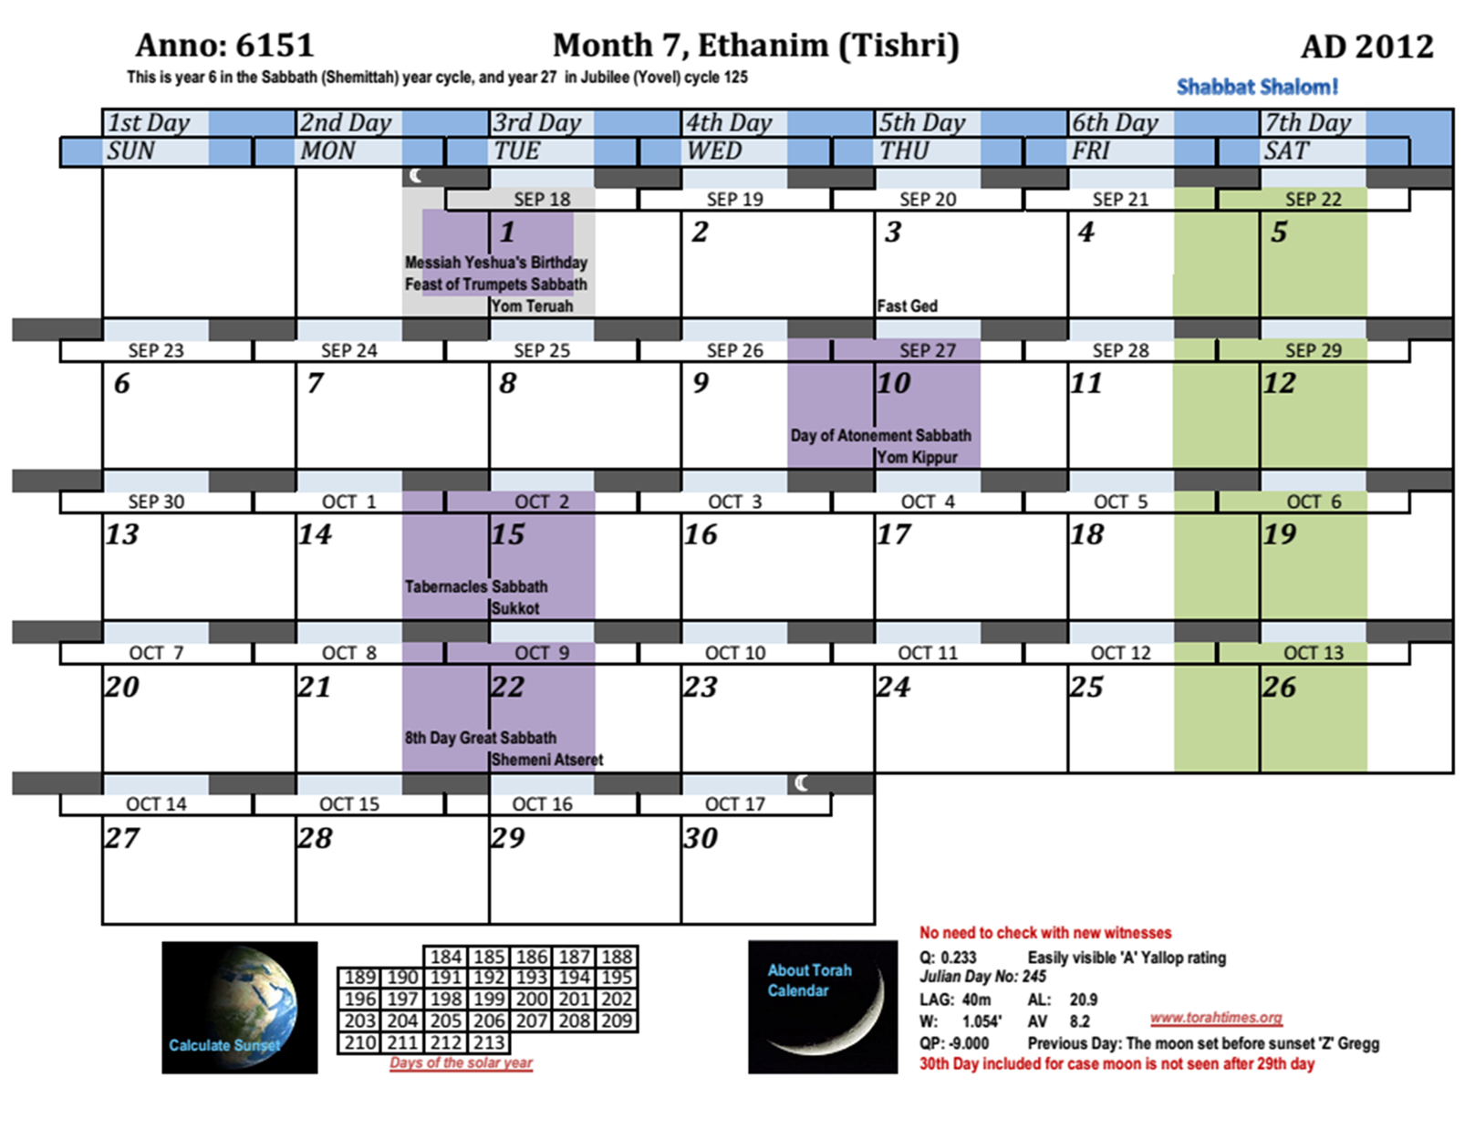
The day and night cycle is shown at the top of the calendar day boxes
A literal day is defined as dawn to dusk as in Genesis 1:5a, “And the Almighty called the light day;”
“And the darkness he calls night”

Slide 4
Annual Sabbaths are shaded purple. They begin with the night and end with the day (i.e. sunset to sunset).
Weekly Sabbaths are shaded green. They begin with the night and end with the day (i.e. sunset to sunset).
Notice how the leading edge of the green aligns with the leading edge of the dark strip indicating night.
Also how the trailing edge of the green aligns with the end of the day. This shows that the Sabbath is from sunset to sunset.

Slide 5
The boundaries of the Roman planetary week are shown starting and ending at midnight. They are aligned with the middle of the dark strip representing the night.
This also applies to the month and day of the Roman calendar. Thus FRI = SEP 21, and goes from midnight to midnight.
The day and night cycle is also shown here; day is shown in the lighter color, and night in the darker shade of red.

Slide 6
Then there was daybreak
וַיְהִי־בֹקֶר
wa|yühî-böºqer
Yahweh created during the day.
Then there was setting,
וַיְהִי־עֶרֶב
wa|yühî-`eºreb
Temple calendar days are shown from daybreak to daybreak (sunrise to sunrise). Burnt offerings offered during the literal day are to burn all night (Lev. 6). See also Lev. 7:15 where the rules for eating offerings use this definition of a calendar day.
… a fourth day
יוֹם רְבִיעִי
yôm rübî`î
A 24 hour day is defined
In the calendar chart, the night at the end is the same as the night at the beginning. The arrows point to the same point in time. This is to facilitate looking at the chart three ways, depending on the day type. It allows sunset to sunset days to be considered if an annual Sabbath lands on the first day of the week. It allows Temple days to be understood if an offering is made and the limits of eating it. It also allows the user to see the Roman day without breaking it into to pieces at the end of the week.

Slide 7
The same night is in two positions in the chart for each week. ONLY ONE can be used depending on the type of day being considered! This chart is designed to allow all day definitions as needed. The user must use only one day definition at a time and not mix them up. Sunset to sunset is for Sabbaths; sunrise to sunrise for the Temple and the ordinary wake and sleep cycle.
This night segment is only considered if one needs to use the sunrise to sunrise definition of day. If needed, then the duplicate night segment at the start of the next week is ignored.
Otherwise, if a sunset to sunset day is needed (such as an Annual Sabbath on the first day of the week), this night segment is used, and the other disregarded.

Slide 8
If considering creation days or Temple days for offerings, do not use the night on this side. They are blanked out.
If considering Sabbaths, sunset to sunset, then do not use the night on this side of the chart. I have blanked them out.

Slide 9
To Read Roman days, you need to ignore the repeated 6 hours on each end. I have whited them out here.

Slide 10
When reading the day number, in this case 7th day of the week, or 5th day of the month, read the day number for Sabbaths by the shading (ignore the solid line in the middle).
For temple or creation days types, read the day number between the solid lines. The day number is always set on the daylight part of the day. The daylight part of the day is the same for every day for Sabbaths, the Temple day, creation days, and Roman days. Only which night is considered varies, or in the case of a Roman day, six hours on each side of the daylight part.
Some Scriptures use one day type to define another day type. Lev. 23:32 says “on the 9th day at setting” (this is the sunrise-sunrise day type). Setting happens in the middle of this day, and the next setting in the middle of the 10th day. Thus Yom Kippur is defined from sunset to sunset.

Slide 11
On the left, the year from creation (4139 BC). On the Right, the AD system, which is correct as to Yeshua’s age for ¾ of the year. On Tishri 1, add 1. Easy to remember, “on Tishri 1, add 1”; thus Yeshua has his 2013th birthday on Yom Teruah this year. Of course he is without beginning of days, but we are referring whole years of age completed since he was born of a virgin.
The time of the new moon is shown by the little moon. The new moon day is shaded grey, except in the case of an annual or weekly Sabbath the day is bordered in grey instead of 100% grey.

Slide 12
The LAG time between sunset and moon set in minutes. This says how many minutes one has to see the new moon after sunset. One will have to wait at least 20 minutes.
The character of the new moon for this month is shown here. The messages vary, saying a chance of -1 day +1 day, none at all, or whether eye witnesses will be needed to confirm a close case with the new moon. In the odd cases where witnesses cannot confirm a close case new moon, I issue a corrected chart to agree with the witnesses.
Bernard Yallop’s Q-test for the moon and interpretive message “Easily visible.” Yallop worked for the British Nautical Office.
Yallop’s test for the previous day, and interpretive message.

Slide 13
The top red message refers to the moon at the beginning of the month, and the bottom red message to the moon at the end of the month.
The Julian day number and time of the new moon at the “best time” for sighting. This is about half of LAG time after sunset. The details are more technical.
The arc of light measurement in degrees. In this case 20.9. This measures the angular distance between the center of the sun and the center of the new moon. This value is related to the visibility of the new moon.
The arc of vision. This is the vertical altitude separation between the sun and moon in degrees. This relates to how dark it is at the time of the new moon, and thus affects visibility.
The width of the moon’s lighted portion This figure is more technically correct than the arc of light since it is topo-centrically determined.

Slide 14
At the bottom of the page, a corresponding inset chart to show the number of days in the year counting from the day of the spring Tequfah (equinox). In this case, the first day of the month is the 183rd day of year.
Hyperlink to site for calculating sunset anywhere in the world. The button will not be shown in most charts.
Hyperlink to more technical details. I do not normally show the button.

Slide 15
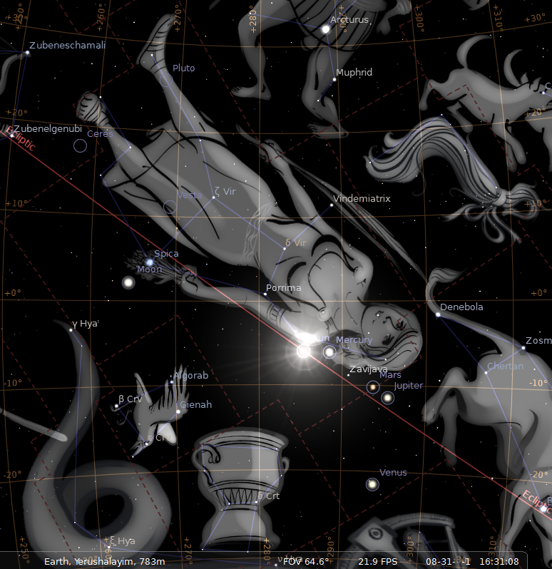
I show the horizon here and a transparent ground where the observer stands.
The time is 16 hours, 31 minutes UTC, about the perfect time for seeing the new moon on this date.
The Heavens on Aug 31, 2 BC. Astronomers use a -1 to represent 2 BC because they count a 0 year that historians do not count.

Slide 16
I use the first sighting of the new moon in all our calendars. Here in 2 BC the moon lines up under the feet of Virgo on Yeshua’s birth date as indicated in Revelation 12:1-2.
In conjunction methods, or the so called “book-end” method, the moon does not line up under the feet, but is too close to the sun.
The woman is clothed with the sun here. Revelation 12:1-2. The sighted moon method reproduces the sign. Conjunction methods cannot.

Slide 17
The reproduction of Revelation 12:1-2 as a sign in heaven confirms the testimony of Messiah Yeshua, and also confirms that the sighted moon method is Scripturally correct. False teachers cannot reproduce the scene. Watch for them to alter the output of their programs. This scene is taken from the free astronomy program Stellarium. All objects are as the program presents them. I have altered nothing.
Notice the BRANCH in the RIGHT hand of Virgo. The “Branch” is a Messianic title for Messiah.
Notice the sheaf of grain in the LEFT hand of Virgo. “Spica” means an “ear of wheat” It is a close binary star. An ear of grain is a “seed.” Seed is another reference to the Messiah first used in Genesis 3:15.

Slide 18
Notice that seven wandering “stars” have assembled for Messiah’s birth!

Slide 19
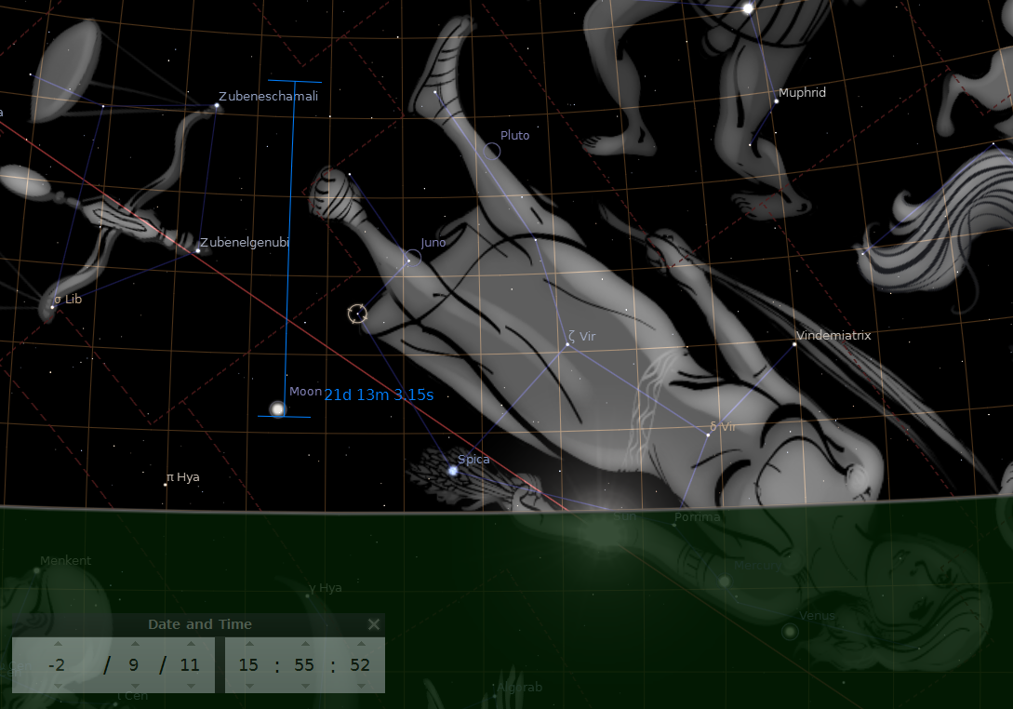
Complete Miss of Moon being under the feet of Virgo in 3 BC
The true facts are unforgiving.
Consider the relative poverty of this scene from 3 BC, where the stars are not lined up for Messiah’s birth.
Both Jack Finegan and Ernest Martin referenced Augustus’ enrollment as “Father of his Country” by all the Romans in 2 BC, but they incorrectly placed it in 3 BC by assuming that the people swore to it before the Roman Senate made it a law in Feb. 2 BC.
Location of Moon on Sept 11th 3 BC
The left foot is sometimes drawn between the arrow points. It is still a miss.
At least one website tries to redraw Virgo with the toe of the left foot at the red dot to make it look like the moon is under the foot in 3 BC. Ernest L. Martin in his book shows Virgo standing up with the same drawing as this website. His drawing on page 85 is a drawing and not a computer generated star chart as the one above. He shows the ecliptic and the drawing of Virgo wrongly drawn below the ecliptic. While there is a little latitude in drawing the constellation, Virgo cannot be drawn the way he has it due to the star “Spica” occupying that position in the sheaf of grain seed the virgin is holding. This put the lie to the words “Everything fits perfectly in this relationship” that Martin wrote. The match is perfect in 2 BC without any re-engineering of the charts.
Sunset, with ground horizon line shown.
3 BC: (astronomers use a 0 year)

Slide 20
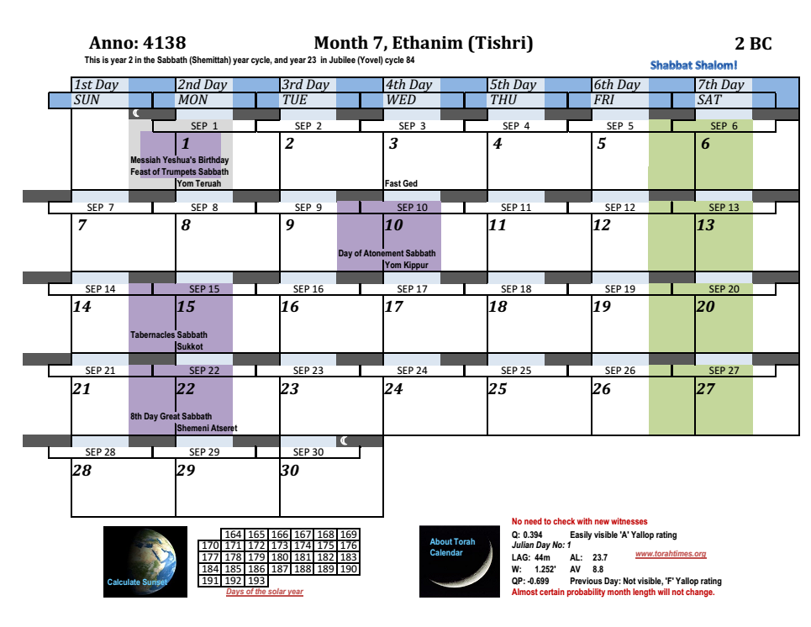
Another problem with the Tishri 15 (vs. Tishri 1) date is that Rev. 12 says “and she cried out, being in labor and in pain to give birth.” Miriam was already in hard labor on Tishri 1 at the new moon. “Being in labor” is a present tense participle. It is not reasonable to think she was in labor like this for two weeks.
The Year of Messiah’s Birth
Yeshua was born on Tishri 1, the 1st day of the 7th Month after about 270 days since his conception.
It is also not reasonable to deny that the sun-moon-virgin-twelve stars correlation points to any other date for the birth than the one indicated by the astronomical sign in heaven.
This also correlates with the stated intent in Genesis 1:14 for the lights in the heavens to be signs. If the sign is reduced to ambiguity by misinterpretation, then its value as a sign is ruined. Yahweh clearly meant the heavenly clocks to be precise.
A faulty interpretation of John 1:14 and insufficient attention to the detailed correlation of Rev. 12:1-3 has caused many to assume Yeshua was born on the first day of the feast of Tabernacles.
“And the Word became flesh and tabernacled among us” began at Messiah’s conception, and not his birth. The baby inside Miriam was Yeshua’s tabernacle for the whole nine months. Yeshua was among his people for his whole life, starting at conception. John’s statement is not meant to decode to Tishri 15, but to underscore the importance of Yahweh taking on human form.

Slide 21
The use of the sighted new moon to confirm this date shows that the sighted new moon method is the correct Scriptural method for determining the new moon.
Conjunction methods cannot achieve this with both Messiah’s birth on Tishri 1, and his crucifixion on Aviv (or Nisan) 14.

