Slide 1
The critic at the torahcalendar website:
http://www.torahcalendar.com/GRADEQUIZ2.asp?Q=6
has taken it upon himself to copy my graphics in an attempt to refute my 2 BC position for the birth of Messaiah without saying where he got the graphics, nor citing the author (me Daniel Gregg) or my website (www.torahtimes.org).
The torahcalendar owner remains anonymous and unidentifiable, although I have some suspects. (Now identified. See last Slide).
His error turns on two points:
Not understanding the ancient method of determining the spring equinox.
Assuming that the baptism of Messiah was in the spring.
This file is about point #1, but I will mention the rebuttal to point #2, which I dealt with previously. Yohannan was only 6 months older than Yeshua. The spring of AD 29 marks his ordination to the priesthood at age 30. Yeshua’s baptism will therefore follow by 6 months when he is ordained to his ministry by Yohannan, shortly before his (Yeshua’s) 30th birthday.

Slide 2
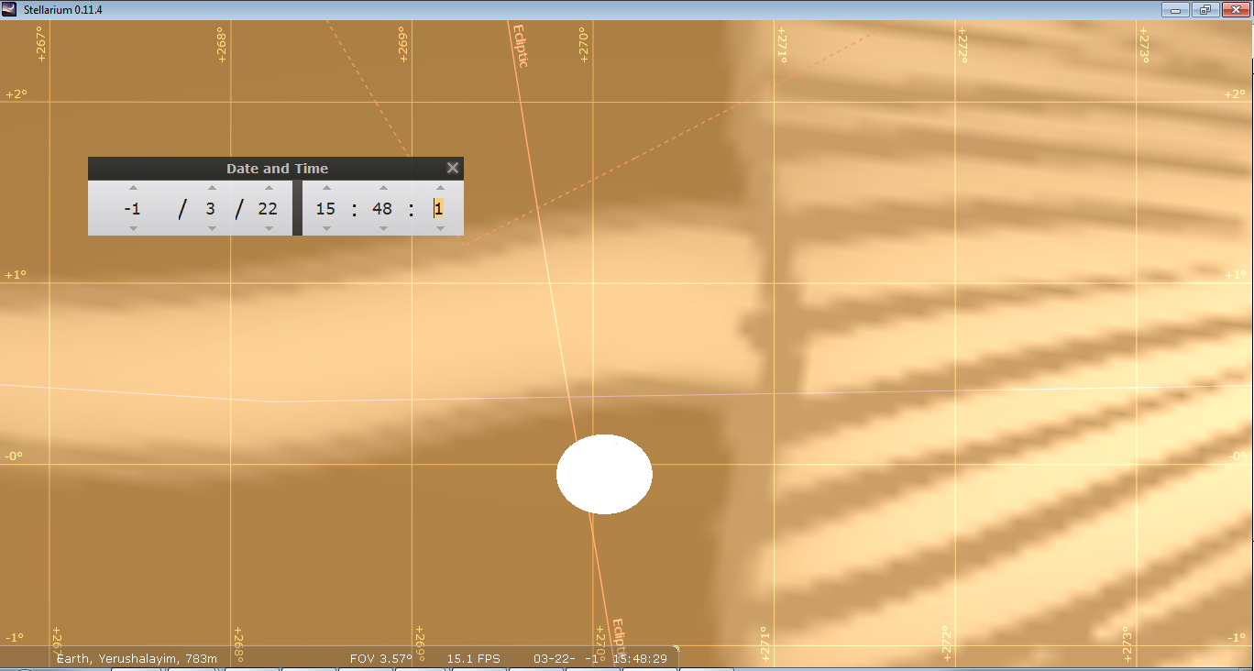
Here is the Stellarium calculation for March 22, 2 BC., near sunset on the 15th day after the new moon. With the atmosphere setting ON, so that the view of the sun includes atmospheric refraction , the sun center has passed through 270 degrees (due west) before the sun has set. A sunset due west, or having passed through due west on that day, defines the spring equinox or beginning of the year.

Slide 3
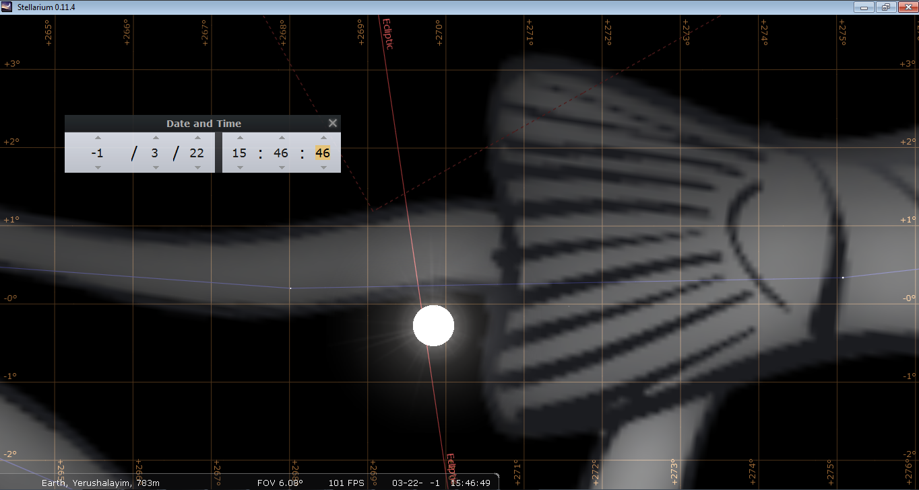
Here is the same Stellarium shot on March 22, 2 BC, near sunset on the 15th day of the month with the atmospheric refraction turned OFF. Without the refraction the sun is shown as NOT having passed the equinox point (due west, 270 degrees) at sunset. This is not what the ancients would have observed. They did not even know about refraction, and much less even how to calculate it. Therefore the practical method of the equinox for the Jewish community was when the sun appears to set west, as in the previous slide.

Slide 4
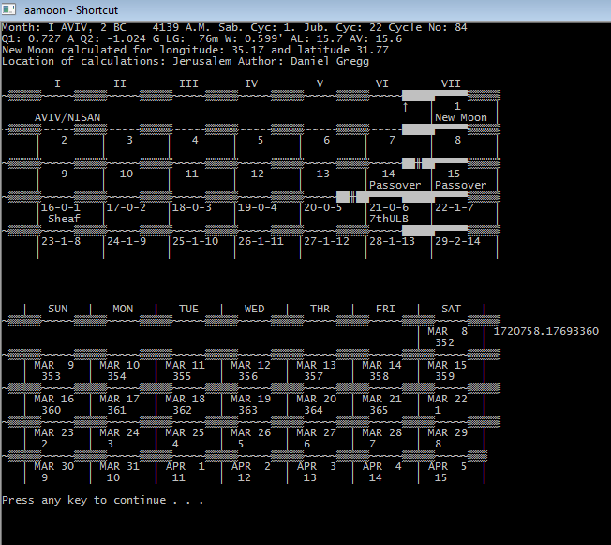
Here I have set the equinox day according to what the actual eye would see in 2 BC. The sun sets due west at sunset on March 22, 2 BC, making this the first day of the year, which lines up with the 15th day of Nisan. This is how the equinox rule is applied.

Slide 5
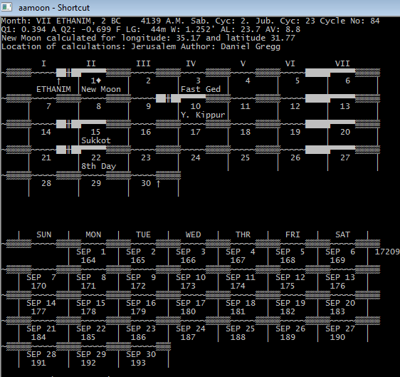
Here I am showing the 7th month in 2 BC. The first day of the 7th month falls on Sept 1, 2 BC. The moon would have been first seen the night before on August 31st.
Once we get the observed equinox down correctly, it is clear that this is the 7th month, and not the 6th month as some allege.

Slide 6
The owner of torahcalendar.com has now been identified by a helpful friend. I am not going to take the liberty at this time to identify the person to the Messianic community, except to say that this person contacted me many years ago, and I pointed out that Rabbinic and Talmudic Chronology was extremely flawed. I also pointed out to him in person that his Jubilee calculation was incorrect. I can also say without a doubt that this person’s date for Messiah’s crucifixion and resurrection was derived from my research, for which no credit has been given. He mentioned me on his website, but not in any of these connections. I believe this person is also an Israeli Citizen by marriage to a Jewish woman, and know for a fact that his original citizenship is Canadian. This person has also summarized or paraphrased significant portions of things I have written without giving me credit for them on the torahcalendar website. I think the term for that is plagiarism. Here is my warning to this person: if you attack my work again on your website, or call my teaching “false teaching”, I will expose who you are to the Messianic Community. Further, since you publically attacked my work in a published format, this is not a Matthew 18 matter. I already told you that you were incorrect in private in any case, and you did not listen. If you target me, I will have no choice but to expose your identity so that you can become accountable for your words.

